Slide 1

Customer Complaint
By :boyang Fu

Slide 2
Why choosing this data
This is a real dataset, and the content are more complex
It related to business, which means my work is practical
It allows me to apply mosaic plot, bar plot, p value and decision tree in this dataset.

Slide 3
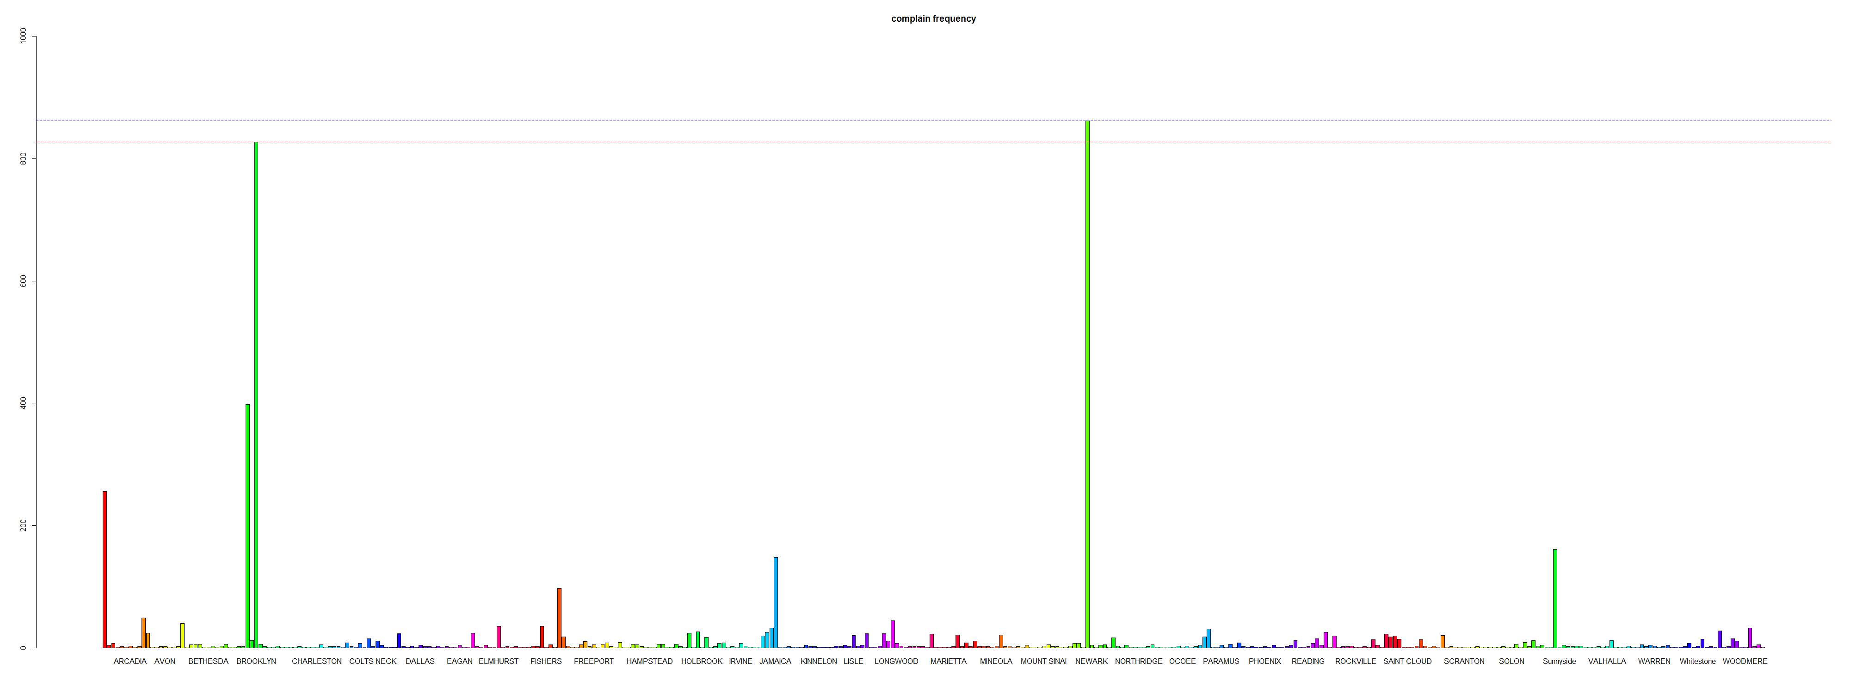
Find the complaint hotspot
New York
862
Brooklyn
827

Slide 4
Contract data
Customers Complaints
Get customers’ reports
Satisfy related to goods

Slide 5
Refine the data
Delete the data which didn’t report satisfaction (Because we are sticking to this)
Delete all the extreme conditions which don’t have a high frequency ( Easy to become overfitting)

Slide 6
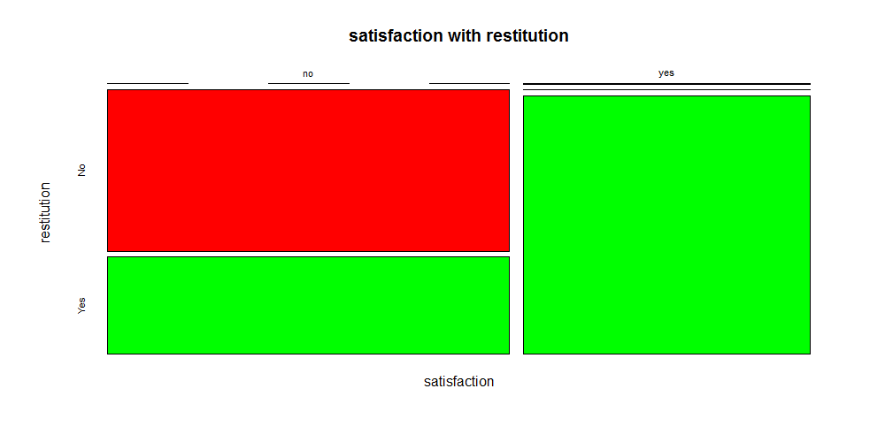
The relationship between Satisfaction and restitution
The person who get restitution, no matter how much, will most likely to be satisfied

Slide 7
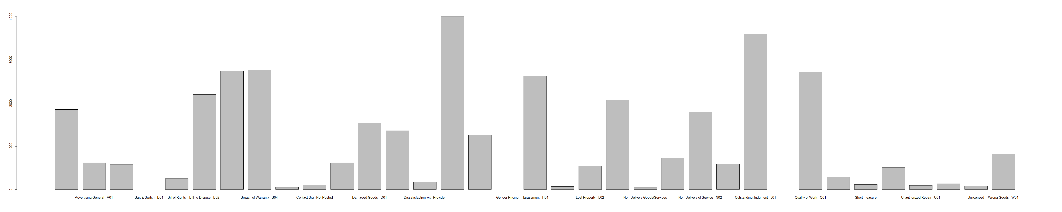
Restitution related to complaint types
Quality of work
Damaged goods

Slide 8
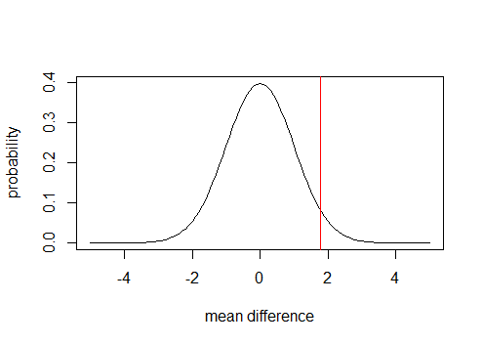
Are people need more restitution on bad service than on bad goods?
Subset the data, only leave the data with restitution >0
Do Z-Test
Result:
I got a zeta of 1.77 and a P value of 0.038 (smaller than 5%), there is no other hypothesis so I don’t need to use Bonferroni correction
So people do need more restitution on bad service

Slide 9
How can we satisfy customers without paying money?
Finding : People who have problem related to goods rather than service are harder to be satisfied!

Slide 10
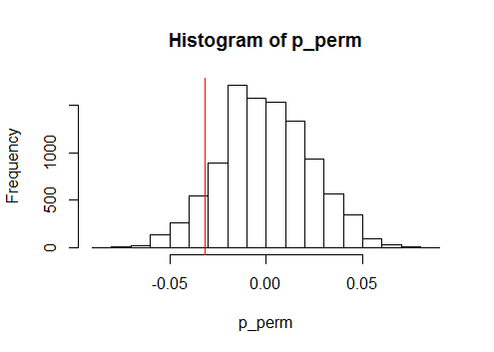
Not so fast!
The P value of satisfaction &goods is 0.0816, which is a little higher than 5% , which means there is not enough evidence to say we should focus more on goods qualities

Slide 11
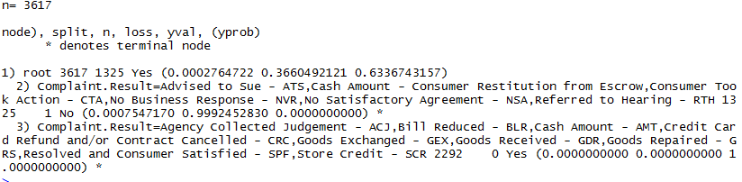
Using decision tree to find the relationship between Satisfaction & result
If the complaint result ATS, CTA, NVR, NSA, RTH, consumers are unsatisfied
If the complaint result are ACJ, BLR, CRC, GEX, GDR, GRS, SPF, SCR, consumers are satisfied

Slide 12
Suggestion
Offering restitution is the best way to calm down the customers, but not from escrows
Think twice before you deciding to do business in New York or Brooklyn
Don’t response nothing to the customers until they begin to take actions

